Slide 1

Simulated Swarm Team 25
Sponsored by Lockheed Martin

Slide 2
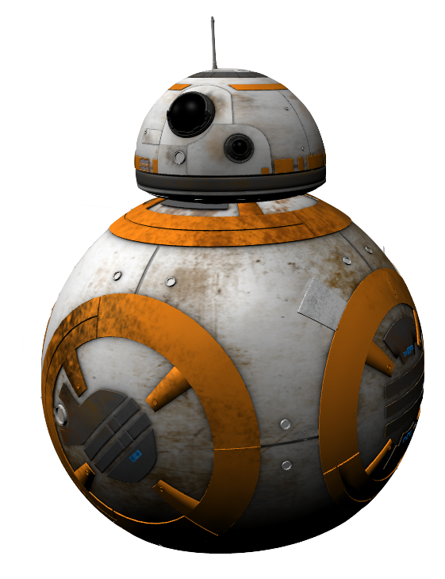
Goals and Objectives
Spawn a swarm of drones to locate a target(BB-8) in a simulated urban environment
Implement object detection
Efficiently map the urban environment using our drones
Integrate methods for pathfinding
Research and implement drone swarm intelligence

Slide 3
Team
Huy Pham - Project Manager
Coordinates team meeting dates and agendas
Responsible for meetings with the sponsor
Track all tasks in all aspects of the project and make sure that each member is doing what they say they will do
Assist in any component that needs help
Bryce Hitchcock - Robotics (ROS) Specialist
Handle the implementation of the computer vision developed from machine learning and the pathfinding established to construct all of the drones mechanics and how they will conduct search
Will also need to consult with pathfinding specialist to research swarm techniques and how to best synchronize the use of multiple drones
Daniel Cisneros - Gazebo Simulation Specialist
Populate the urban environment and introduce obstacles that the drones might have to face, such as shadows, cars, odd colors, etc
Help produce photos and situations for the machine learning specialist so that the drones are trained for multiple different situations
Will work with the pathfinding specialist to help map the area and give insight on different aspect of the simulated world
Keifer Wheatley - Pathfinding/SLAM Specialist
Handle the pathfinding algorithms implemented with assistance from the Gazebo specialist
Will work closely with the ROS implementer in order to correctly program the drone to be able to traverse the environment
Raymond Price - Object Detection/Machine Learning Specialist
Will work to get the photographs and images needed to create a data set that will be used to train the drones computer vision
Using image machine learning technology, will train the dataset and return a bounding box around the target with a specified accuracy

Slide 4
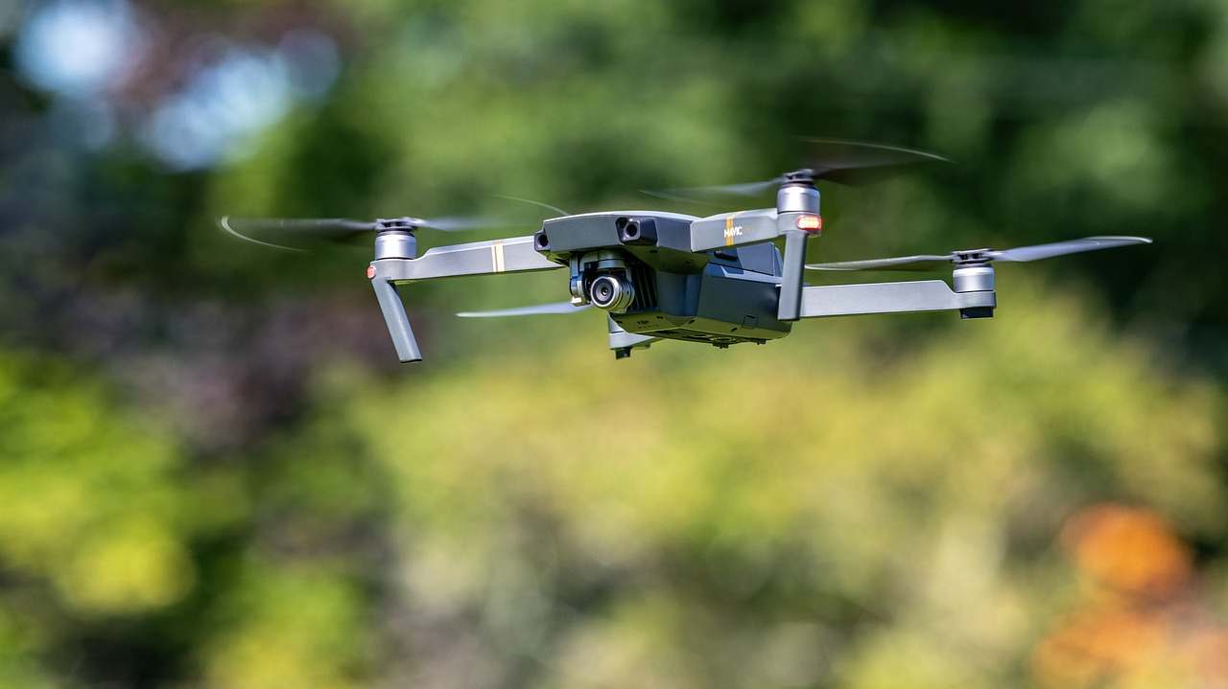
Justification
The area of swarm robotics is fairly new and we can help develop these systems
Swarm robotics have a massive application in reconnaissance missions where speed is a priority or the scenario is too dangerous or impractical for a human examples:
Search and Rescue
Battlefield Threat Detection
Location Mapping

Slide 5
Requirements and Specifications
Must use Gazebo and ROS
4-5 drones
3-min time constraint
Bounding Box around target - must demonstrate IoU > 0.5
Confidence Score - must be above 0.7
Fully autonomous
Target
Not on buildings or in buildings
Obstructed by obstacles:
In the shadow of a building
In an alleyway
Near trash cans

Slide 6
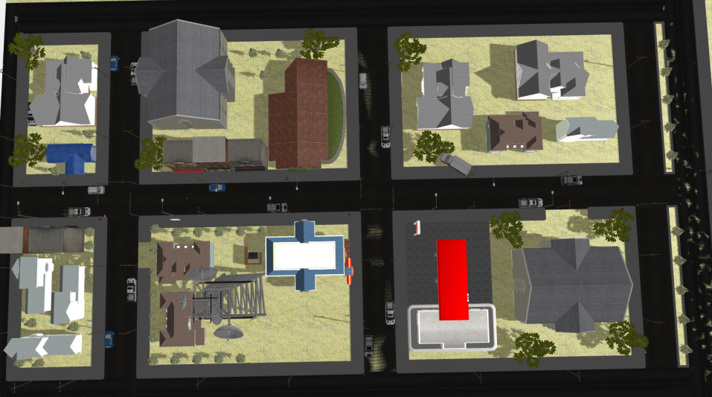
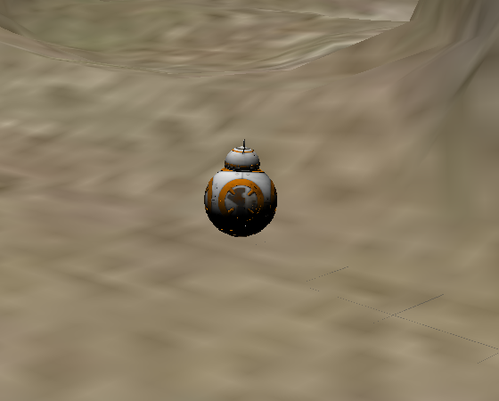
Background
and
Environmental
information
Previous team
Target(BB-8)
Environment
Urban simulated environment should be realistic
Buildings, cars, and other obstacles
Lighting
Physics
At least 400 by 400 feet

Slide 7









Technologies
Notes:
Google drive for non-coding things and github for repository and coding

Slide 8
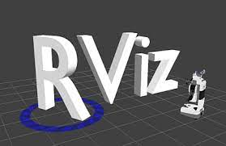


ROS/Gazebo
ROS
Open-source software for Robotic Operating Systems
Easy to write software for drones behavior
Large infrastructure containing tools and capabilities for robot programming
Compatible with YOLO and SLAM
Gazebo 11
Open-source software to implement the environment simulation in 3D
Compatible with Robotic Operating System (ROS)
Build in libraries (robots, objects, and worlds)
Provides sensors, 2D/3D cameras, force torque and more
Multiple access to high-performance physics engines
RViz
Notes:
Why are we using ros/gazebo

Slide 9
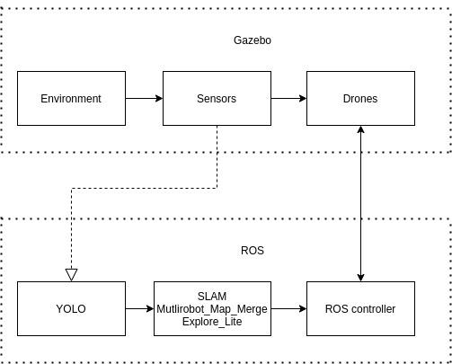
ROS communication

Slide 10
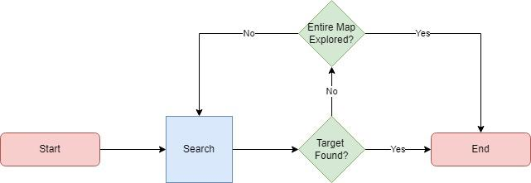
Process flowchart

Slide 11
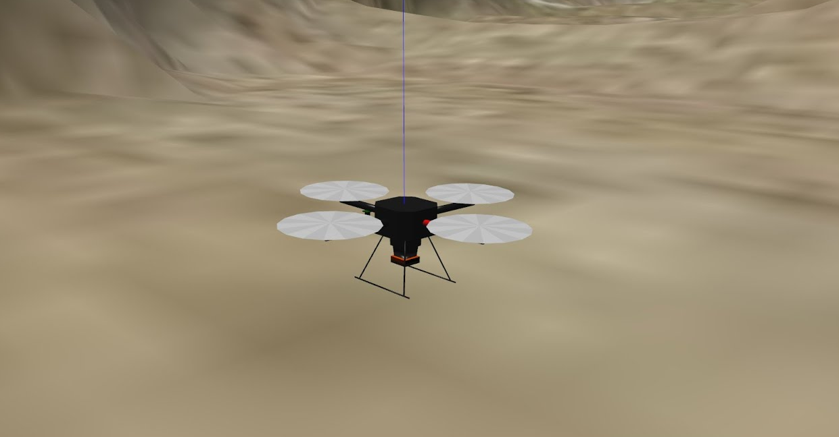
The Drone
Hector quadrotor
Sensors
Default Camera
LIDAR: hokuyo-utm30lx
Future upgrades:
Adjusting tilt
3D LIDAR sensor
Upgraded camera

Slide 12
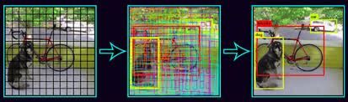
Object Detection
YOLO
You Only Look Once object detection algorithm.
Train a YOLO model for a given object using images
Predicts using a bounding box
Notes:
real-time

Slide 13
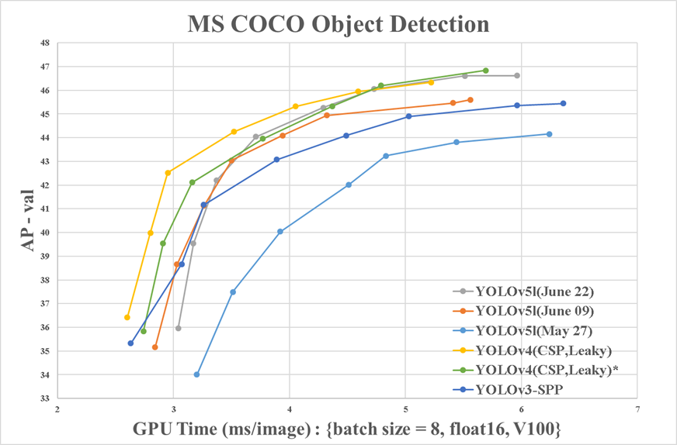
Decision on Object Detection
YOLOv3/YOLOv4/YOLOv5
YOLOv3 current version implemented.
Precision: 0.71
Recall: 0.87
Accuracy: 0.86
YOLOv4 beats the previous version by a large margin in areas detection performance and speed.
Precision: 0.82
Recall: 0.88
Accuracy: 0.89
YOLOv5 most recent version but still not accepted by the community.
Precision: 0.84
Recall: 0.89
Accuracy: 0.91
YOLOv5 migration.
Notes:
V3 is more stable and supported but we are prioritizing performance bc the drone will in motion and we need to be able to analzyze the data in real-time

Slide 14
Training Methodology
Manually create dataset
Partition dataset
Upload all files and algorithm to google colab
Train the model and use the weights

Slide 15
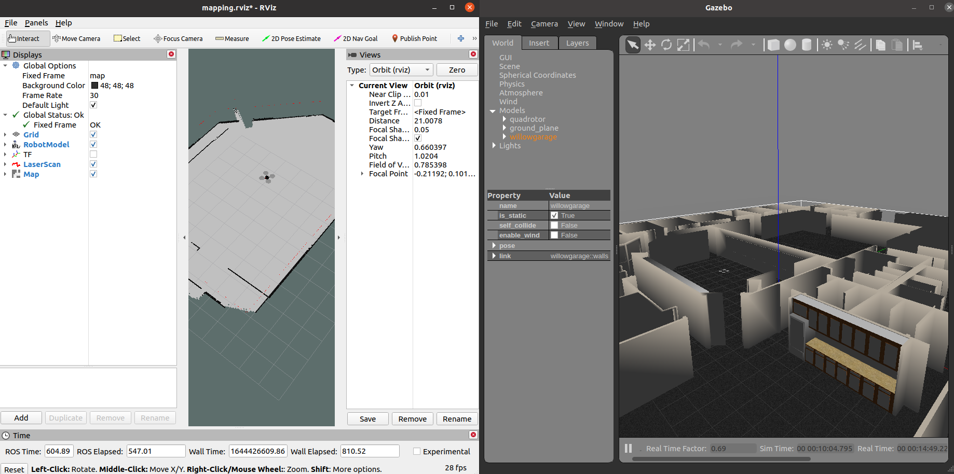
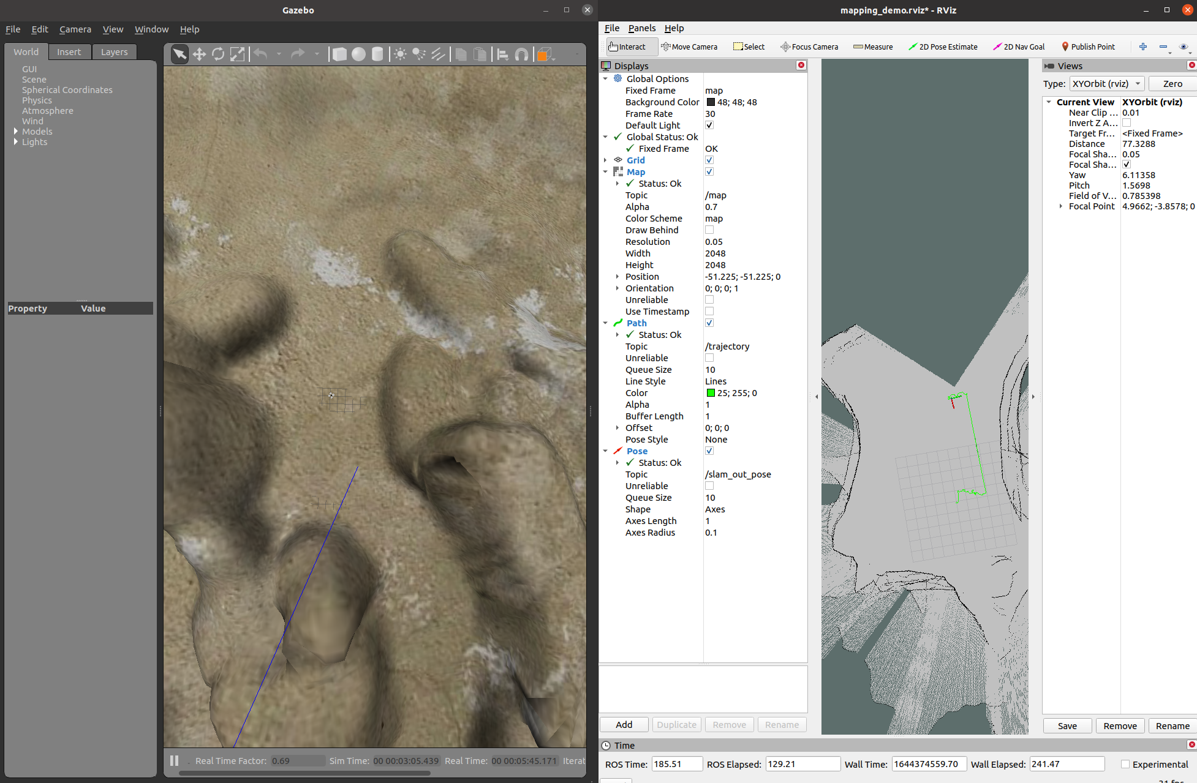
Mapping
SLAM
Simultaneous Localization and Mapping algorithm.
Map environment using robot sensors.
Avoid obstacles
Avoid repeating over finished areas.
Grid-based mapping.

Slide 16
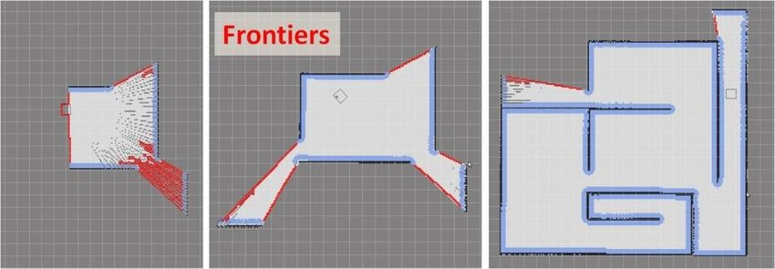
Pathfinding
Local Planner
Takes input only from immediate area
Used for obstacle avoidance
Keeps making new trajectories
Global Planner
Takes input from whole map
Generates path to target area of map
RRT/Frontier Exploration The global planner used in most robotic exploration missions. Creates waypoints on unexplored “frontiers”

Slide 17
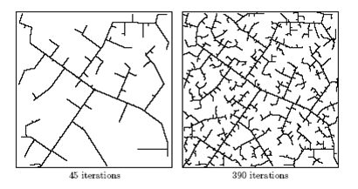
Pathfinding
RRT Algorithm
Rapidly Exploring Random Tree
Randomly builds a space filling tree to search open areas
Incrementally builds tree and is biased towards large, unsearched areas
Used for robotic exploration of unknown areas

Slide 18
Pathfinding
Problems
Not having GPS forces us to have to autonomously explore and navigate unknown environments
Simulated Environment
Large and open
Complicated structures
Fairly new technology that is still being researched means very little information to build off of
Many packages only worked on different versions of ROS
Notes:
Dealing with underpath of buildings and other nooks within the environment

Slide 19
Pathfinding
Current Progress
Working on implementing frontier exploration packages
explore_lite
frontier_exploration
rrt_exploration
Configuring Hector Quadrotor with ROS Navigation stack

Slide 20
ROS Packages
Navigation used to send move commands to robot for autonomous control.
RRT-Exploration package that implements the RRT Algorithm
Explore-lite lightweight exploration package used for autonomous drones
Multi-Robot Map Merge takes the maps created by multiple robots and merges them into a single map to prevent exploring the same area

Slide 21
Swarm Methods
Our goal is to have all drones communicate to optimally locate our target
Concerns: collisions and losing connection
Swarm intelligence options:
Ant Colony Optimization
Particle Swarm Optimization
Artificial Swarm Intelligence

Slide 22
Workflow
Discord
Weekly meetings
Additional meetings for blocks
Different channels
General
References
Downloads
Streaming perspectives
Google drive
Additional files
Zoom/Skype
Sponsor meetings(bi-weekly)
Physical meetings
1-3 per week

Slide 23
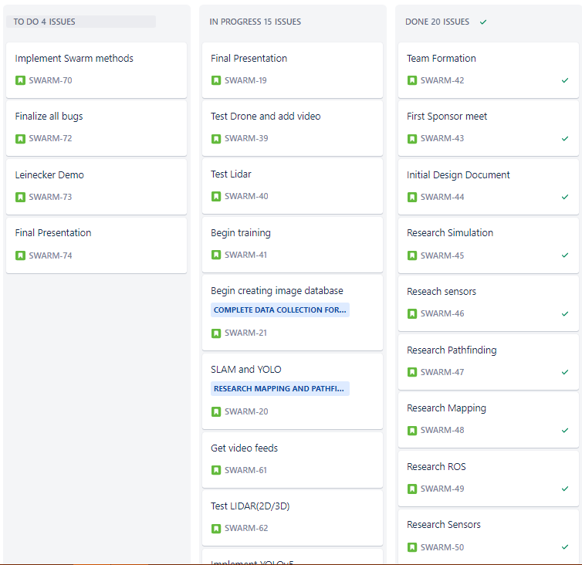
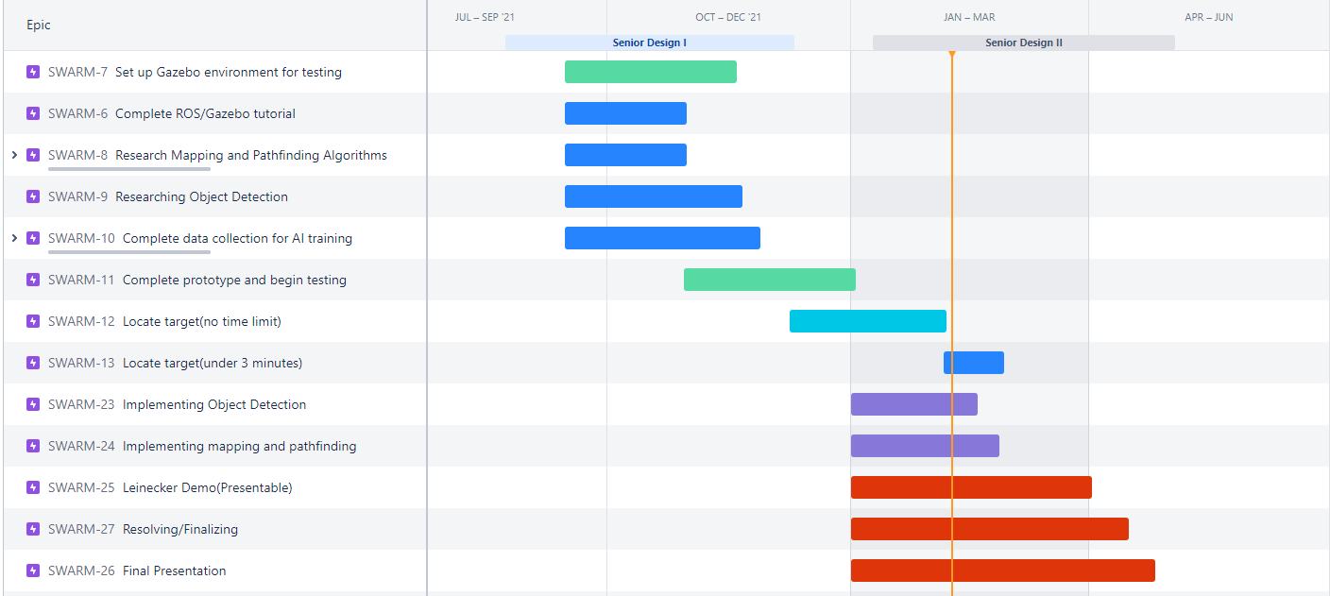
Gantt Chart

Slide 24
Successes
Supporting each other
Independently working
Assigned roles
However, reaching out whenever necessary
Constant communication
Increasing meetings when necessary
Realistic schedules and meetings
Recommendations from sponsors

Slide 25
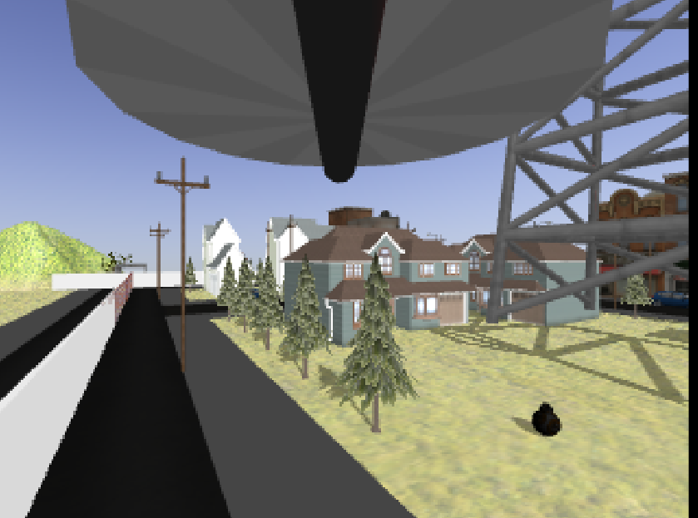
Blocks
Scheduling conflicts
ROS’s difficult learning curve
Unfamiliarity
How to start
Getting a base started before upgrading
Hardware requirements
Some members computers had difficult running the software
Utilizing budget
Underestimating the project
Compatibility issues
Windows/Mac
Different version of ROS
Environmental issues
Lighting problems
BB8 darkened
Notes:
Talks about dark bb-8(lighting problems)

Slide 26


Budget/Cost
Total budget provided by Lockheed Martin - $300
ROS course(1 month)
$300 - 45.28 = $254.72
Software is open-source
Additional udemy courses
Status: Pending

Slide 27
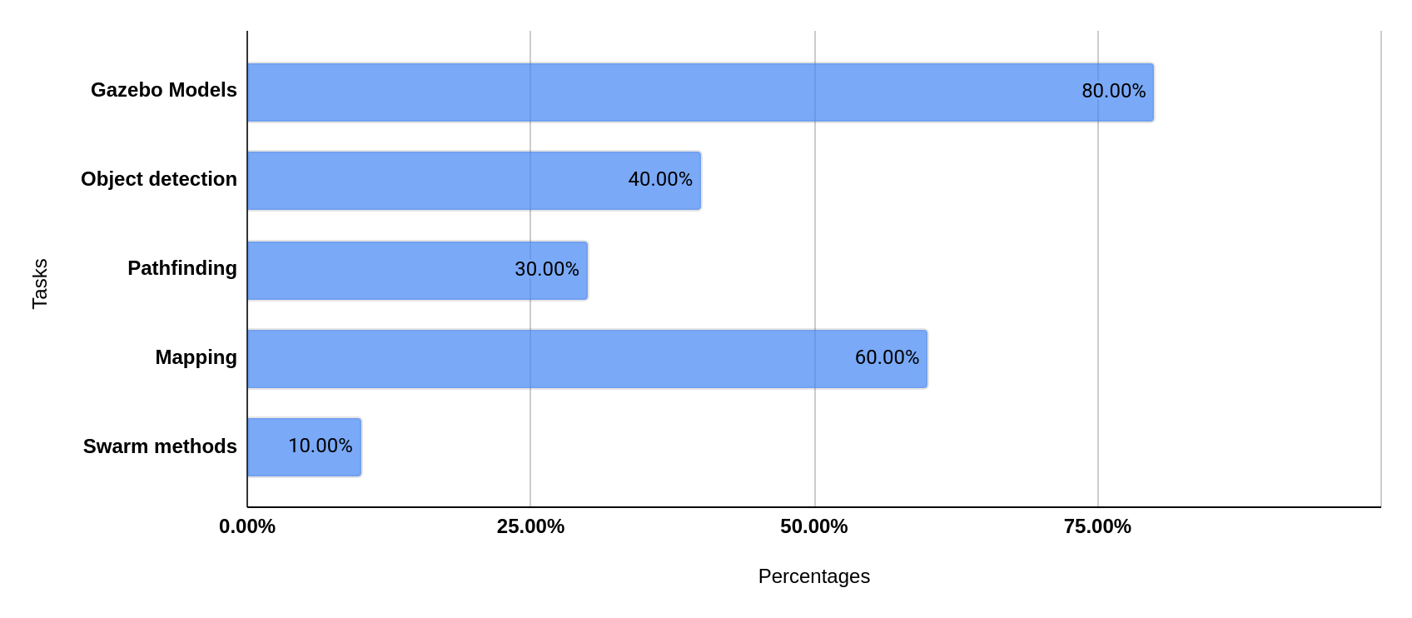
Progress

Slide 28
Milestones
2/17 Finalize training data/Object detection
YOLOv5
2/25 Finalize mapping/pathing
SLAM
2/27 Locating target under 3 mins
3/8 Implement swarm methods
3/28 - 4/1 Leinecker Demo
4/15 Resolving/Finalizing
4/19 - 4/25 Final Presentation

